Slide 1
Hash Society
Amit Kumar Gupta
Akash Kumar
Chandan Kumar
Shreyas Kumar Tah
Roshan Verma

Slide 2
Problem Statement
An analyst at a HFT named ABC Capital and you have observed that nowadays quant algo is giving inaccurate predictions. Our boss has asked us to use sentiment analysis for predicting stock performance. We are required to create a NLP based market sentiment meter for NASDAQ stocks using social media posts of normal users.

Slide 3

Brief about the Idea:
This project is about doing a sentimental analysis using NLP and bringing out relation with the past stock behaviour. The project conclude that twitter tweets have a great impact on the stock market behaviour . To show this we have extracted NASDAQ stocks using social media post of normal twitter user through a data extraction tool Apify, and further relating it with the provider per day trading values of NASDAQ listed companies.

Slide 4
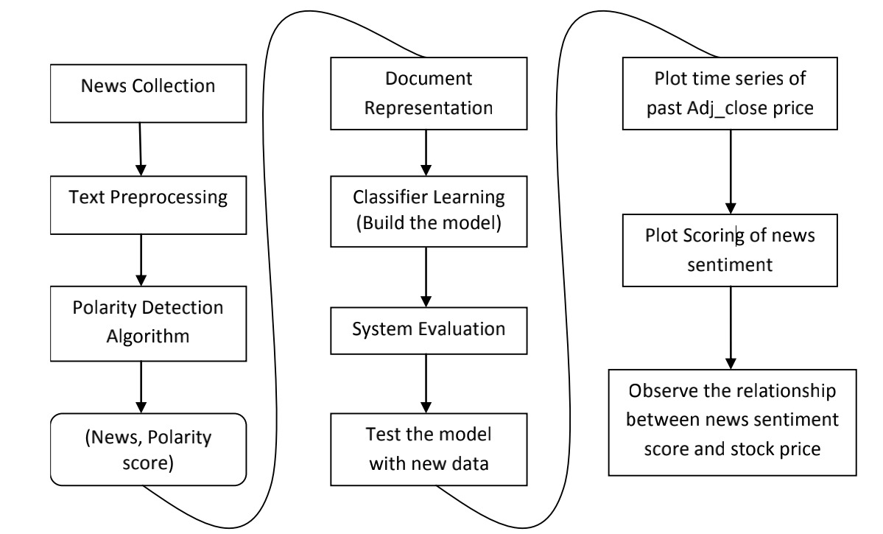
Solution & Strategy
Twitter Tweets
Plot scoring of tweets sentiments
Observe the relationship between twitter sentiment score and stock price
Tweets/ Polarity Score

Slide 5
About the Model
Using Apify extracting tool we extracted the twitter tweets.
NLP is used to extract company’s informations from the twitter tweets.
ML algorithm , logistic regression is to predict bears and bulls of the stock.
Algorithms like Afinn and Vader Sentiment is used to calculate polarity of the tweets.

Slide 6
Algorithm proposed
AFINN- We develop a score sentiment using this algorithm.
VADER( Valence Aware Dictionary for Sentiment Reasoning) is an NLTK module that provides sentiment scores based on the words used.It is a rule-based sentiment analyzer in which the terms are generally labeled as per their semantic orientation as either positive or negative.
Logistic Regression was used for the classification of the sentiment scores into three polarities such as Positive, Negative or Neutral

Slide 7
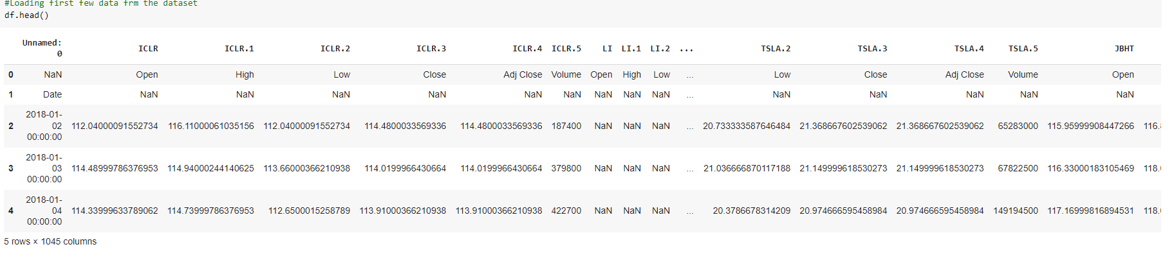
Data Cleaning
NaN values were removed.
Stock company name was restructured to reduce unknown data.
Stock Company with blank spaces were dropped.

Slide 8
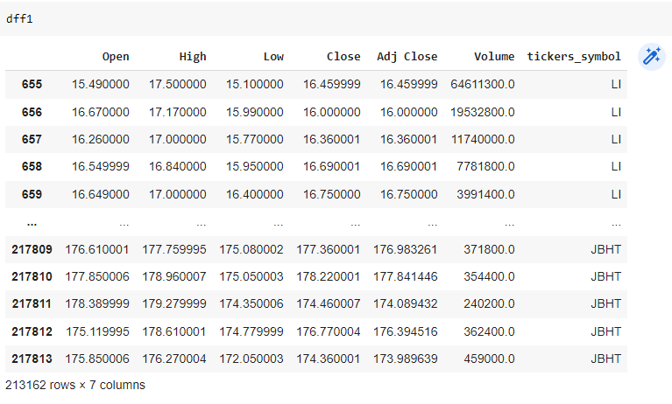
After Cleaning

Slide 9
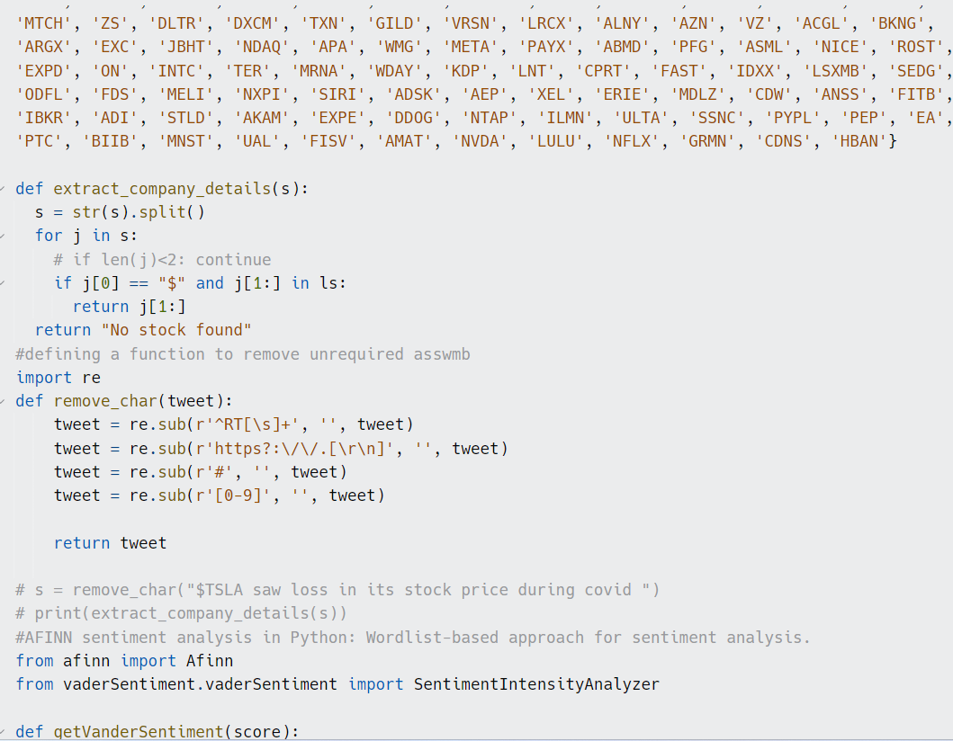
Backend Working of Model

Slide 10
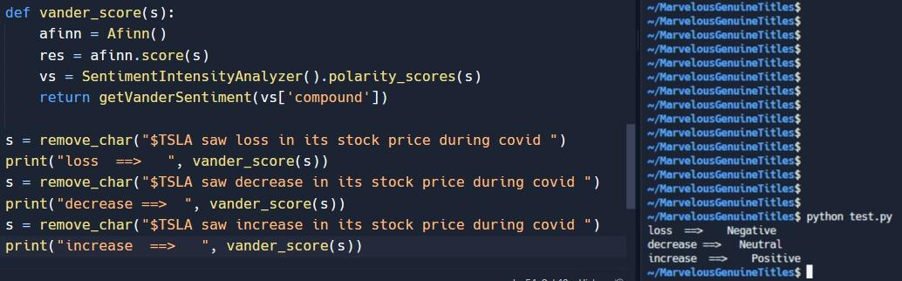
Model Testing

Slide 11
Challenges
We have to deal with huge amount of data(5790 samples).
Actual Trading Strategy.
Ensemble of models

Slide 12
Thank You

